Slide 1
Coursera Capstone Project
Is opening a pub or bar a good idea?

Slide 2
Overview
Business Problem
Data Sources
Assumptions
Analysis

Slide 3
What are we doing here?

Slide 4
Business Problem
An investor is looking for good business opportunity in the city Chennai.
Chennai is one of the fast emerging as a destination for information technology outsourcing and has seen a growing number of IT parks being built here. Most of the upcoming complexes are being built along the I T Corridor and the southern suburb.
These IT parks are hubs for major companies and employs educated segment of Indian Society especially youth fresh from Universities in large number.
The youth with new financial independence enjoy drinking and to socialize after work.
Hence, opening a Pub near upcoming IT park seems like a good real estate investment.
A Spatial and other relevant Data Analysis on how existing Pubs/Bar are located near IT Parks is important to analyze if this investment is feasible.

Slide 5
How are we getting there?

Slide 6
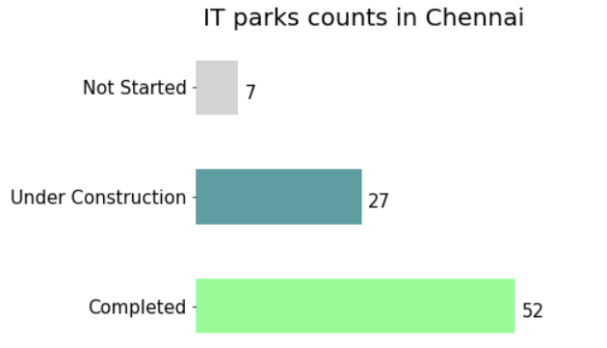
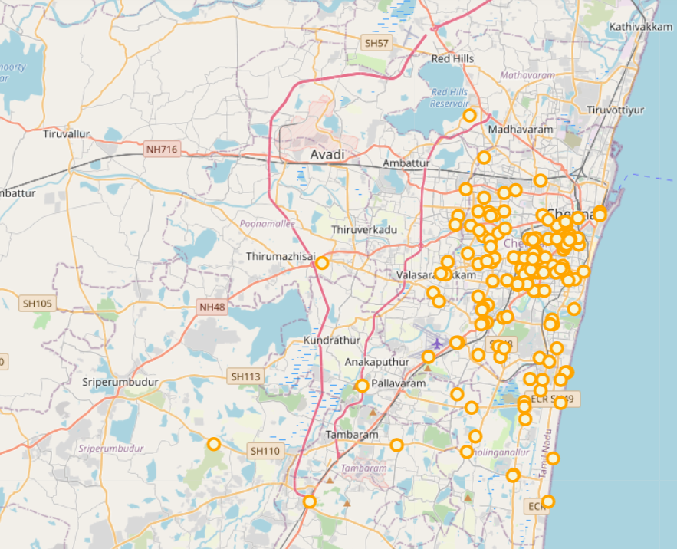
Data Sources
Source 1: List of IT parks in Chennai:
The sample list of IT parks with the construction status (completed, under construction, not started (planned stage)) is extracted from the Wikipedia.
Source 2: List of Pubs/Bars around those IT Parks:
The Foursquare API is used to generate the Pubs/Bars around 3km radius of the IT Parks.
Source: “https://en.wikipedia.org/wiki/List_of_tech_parks_in_Chennai‘’
Mapping of Pubs/Bars in Chennai
Source: “FourSquare API used to map the Geocode of Pubs/bars in Chennai‘’

Slide 7
Just Remember…

Slide 8
Assumptions
1. The impact of following is assumed not to affect the decision of the investment:
Density of population and income distribution of the particular area.
Universities, tourist places or other popular, other commercial offices/places
Infrastructure development of the area, overall popularity/history of the are
Availability and prices of land/rental spaces in area
The footfall and profitability (number of people visiting the pubs/bars) of the bars/pubs
Investor financial constraints
2. The ‘Foursquare API Constraints
Limitation of only 50 items per API call, hence completeness is not confirmed
The categorization of venues is considered as per Foursquare API
API version is used for Dec 31, 2020

Slide 9
Assumptions
3. The Wikipedia source is not updated as on date .However, for this analysis, this source is considered a reasonable sample. Furthermore, relevant updates, has been made by verifying through internet search.
4. Places which are tagged or categorized as restaurants have been excluded, these may serve alcohol. The focus of the research here on investment in pubs and bars near to an IT park.

Slide 10
Why it is a good idea?

Slide 11
Analysis >>>>

Slide 12
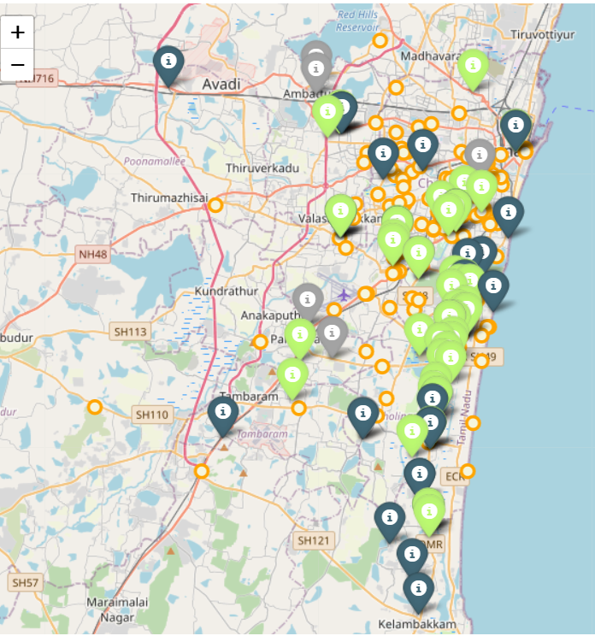
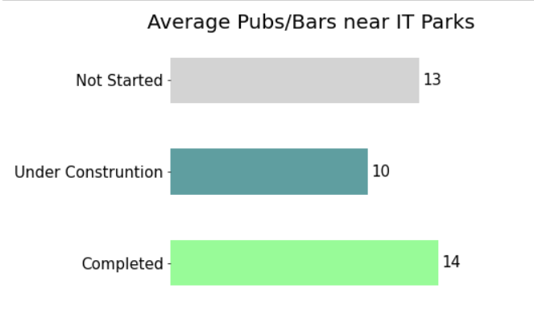
Spatial Mapping of IT Parks & Bars/Pubs in Chennai
The average bars/pubs near under constructed in 10 as compared to 14 around completed IT Parks.
There are many upcoming IT Parks on the southern borders of the city and it could be a good place to open a pub/bar.
The majority of pubs/bars are around the completed IT parks, with few exceptions.
The planned (not started) IT park are near the area where there are already pubs/bars and completed IT parks. Hence average is high.
Map Legend
Green popup | Completed IT Parks
Blue Popup | Under Construction IT Parks
Grey Popup | Not Started IT Park
Orange Circles | Pubs/Bars

Slide 13
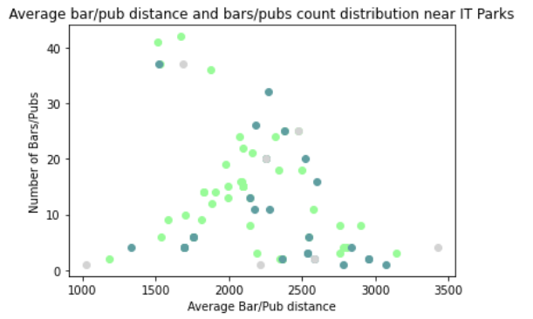
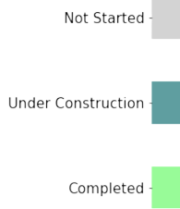
There is clearly a trend with bars/pubs counts near an IT Parks. As distance increase from IT park, the bar/pub count is reduced.
(observe trend for completed IT Parks)
Hence, opening of Pub/bar within 2200 meters is advisable.
IT Park Status | Closest Bar/Pub (meters) | Average Distance of a Bar/Pub (meters)
Completed | 770 | 2,127
Under Construction | 1,327 | 2,237
Not Started | 1,208 | 2,284

Slide 14
Thank You!!!

